Slide 1
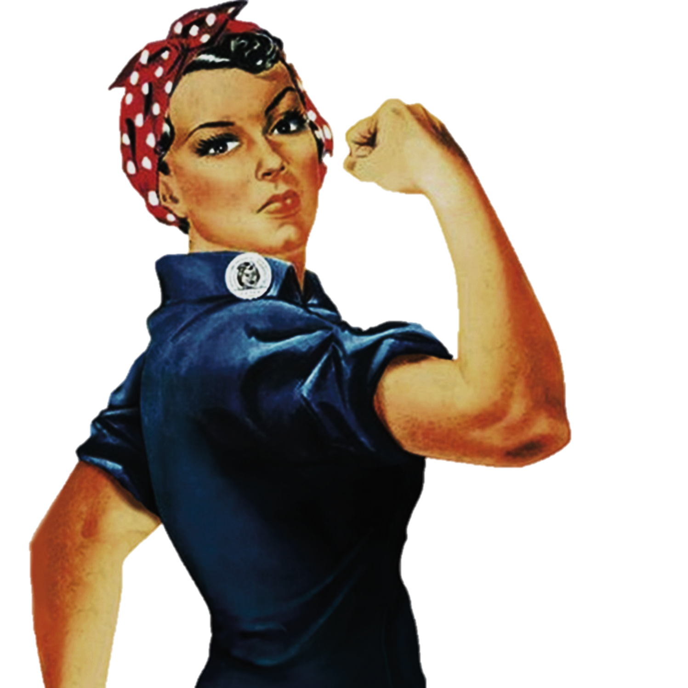
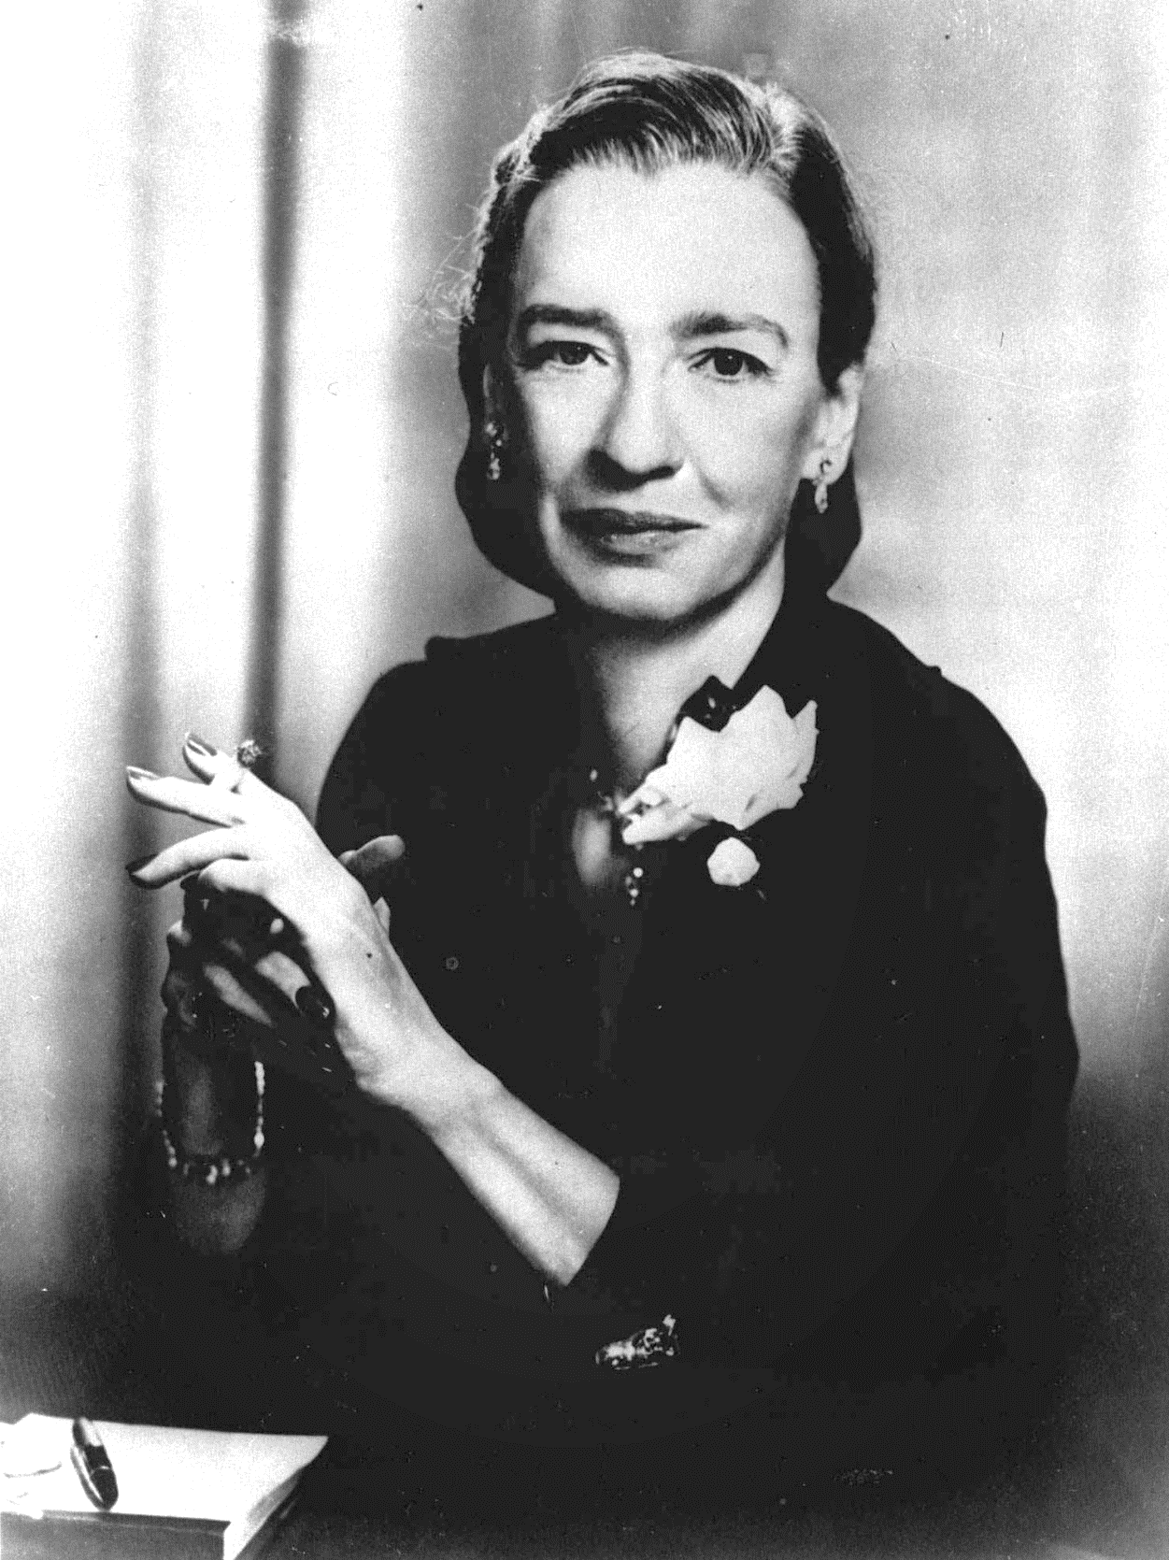

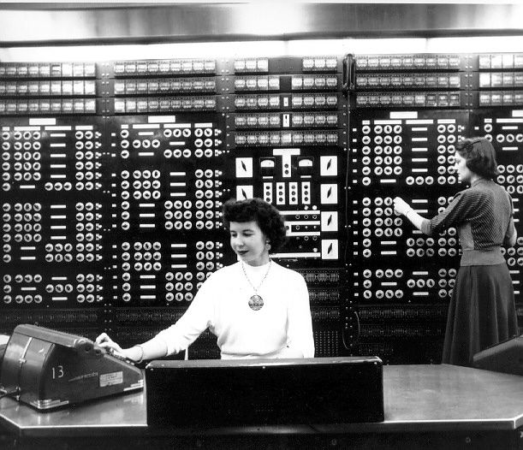
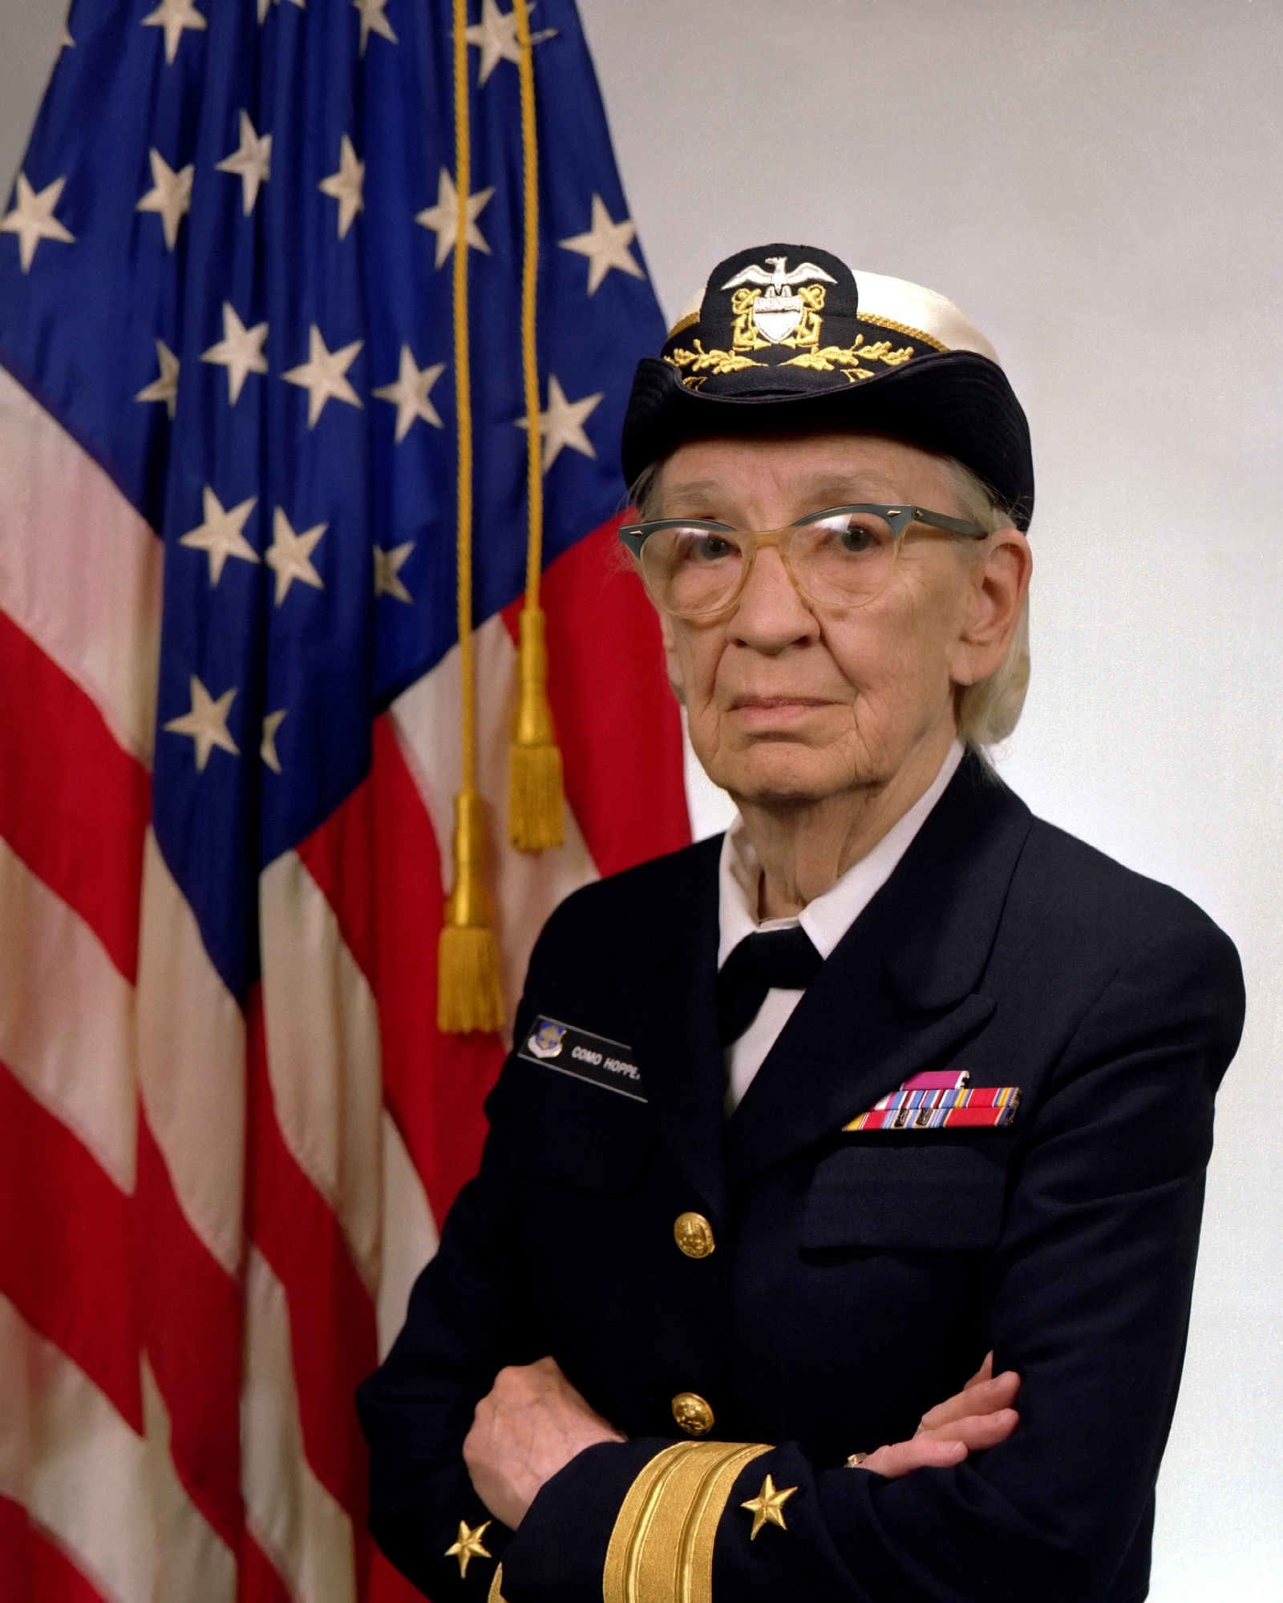
Women
“Amazing”
Grace
Hopper
To change pictures:
Save the picture of the person you wish to use.
Single-left-click the grouped picture/shapes you wish to change on the poster. Single-left-click again on the picture.
Now single-right-click the picture and select “Change Picture” from the menu.
Choose the picture file you saved.
You may wish to single-left-click the grouped picture/shapes and single-left-click the new picture again to adjust its size or crop it—especially useful if the new picture is not the same aspect ratio as the previous one.
DO NOT CHANGE ROSIE THE RIVETER PICTURE!!!
In Technology
1928 Bachelor’s & Master’s in Math - Vassar
1934 Ph.D. in Math - Yale
1943 Sworn into Navy Reserve “WAVES” – Women Accepted for Volunteer Emergency Svc
1944 One of first programmers of the Mark I computer as a Lieutenant JG
In 1949, when describing her dream of a programming language based on English words, she was told she couldn’t do it because “computers didn’t understand English.” Three years later, she had developed the world’s first compiler. “Nobody believed it,” she said, “they told me computers could only do arithmetic.”
In 1983, after retiring and being recalled to active duty twice, Grace Hopper was promoted to the rank of Commodore (later renamed Rear Admiral). She finally retired in 1986 after a 42-year career. “The most important thing I’ve accomplished,” she said before her death in 1992, “other than building the compiler, is training young people. They come to me and say ‘Do you think we can do this?’ I say, ‘Try it.’”
What can you do with technology that nobody thinks can be done?

